Slide 1
Presentation brief for MCT’s
Title of presentation | Compute Contexts
Presentation length | 120 minutes (including labs)
Audience | Data Scientists planning to operate machine learning workloads on Azure
Purpose | Introduce Environments and how to create and use them Introduce Compute Targets and how to create and use them
(think) Student key takeaways | Environments encapsulate a conda execution environment. Compute Targets provide local or remote compute on-demand
(feel) Student desired mindset | Confident working with environments Confident selecting and working with compute
(do) Student outcomes | Create an environment and use it in an experiment Select and use a compute target to run an experiment
More information | For course feedback, please use the MCT Forums

Slide 2

Module 5: Compute Contexts

Slide 3
Agenda
Working with Environments
Working with Compute Targets

Slide 4


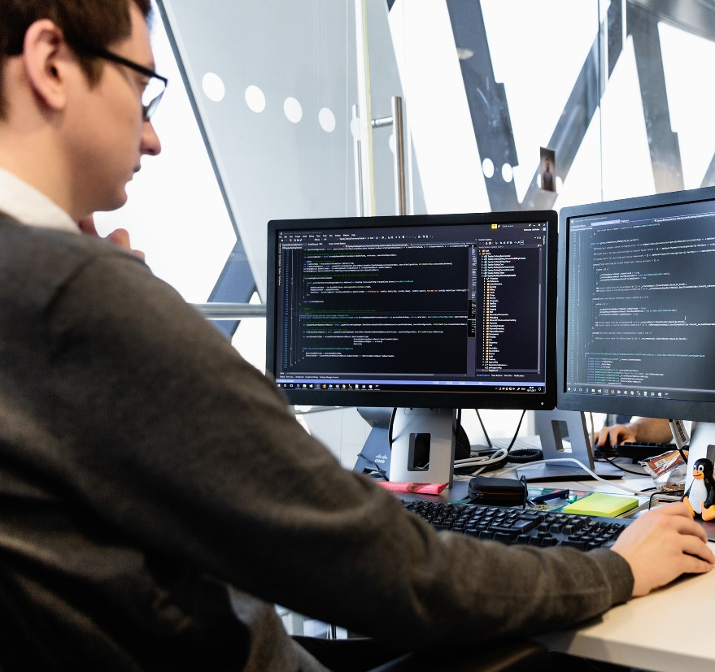
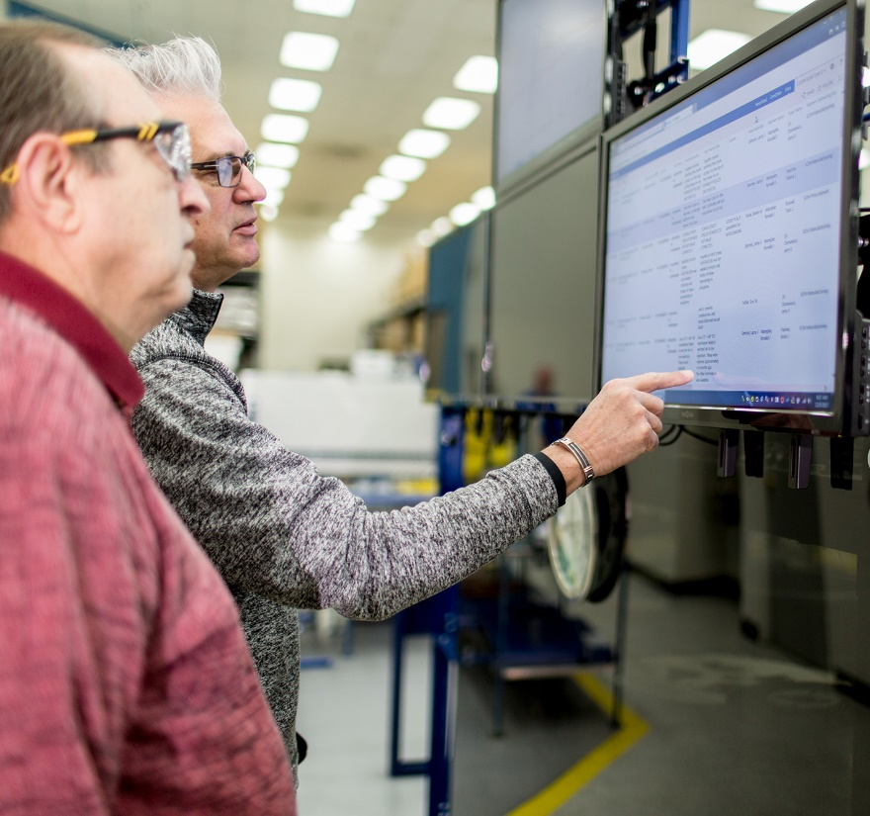



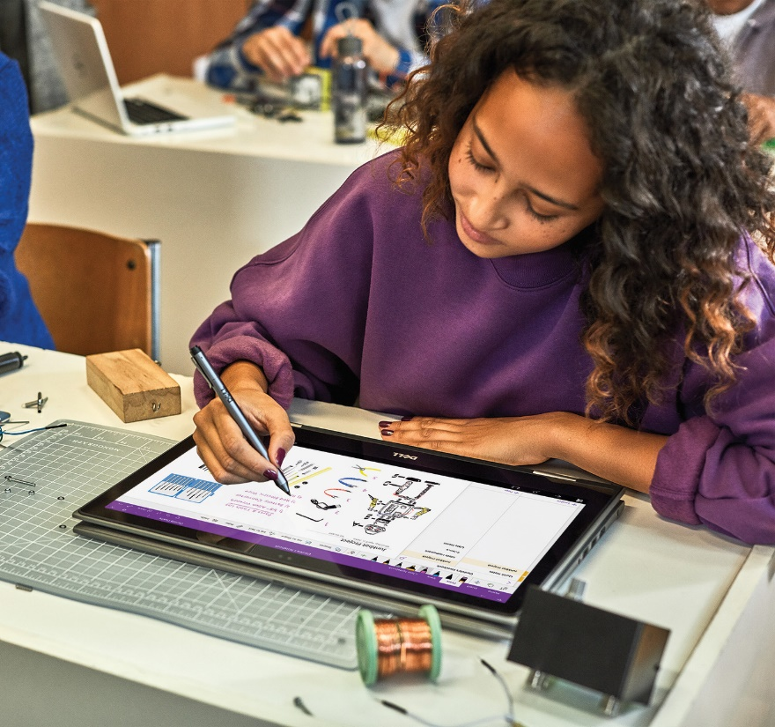


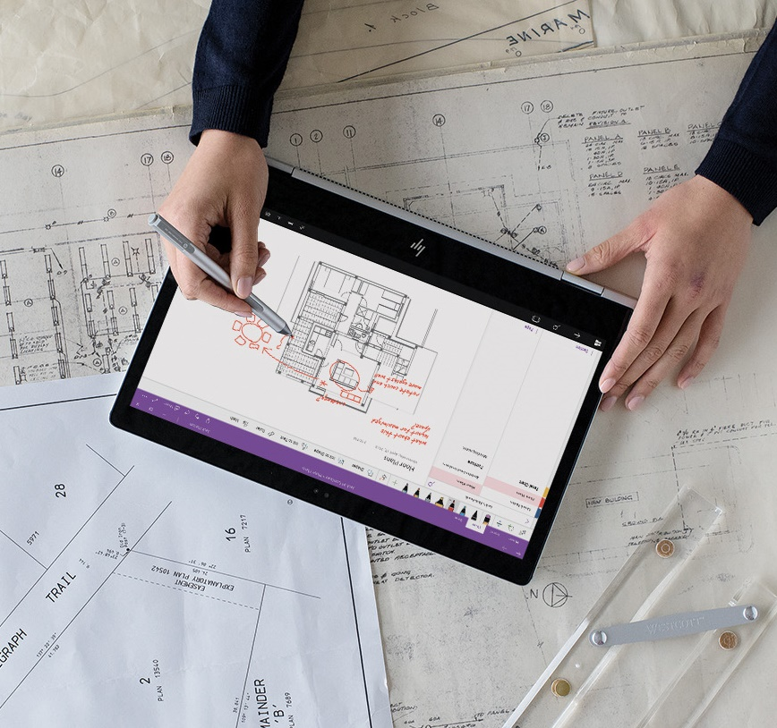

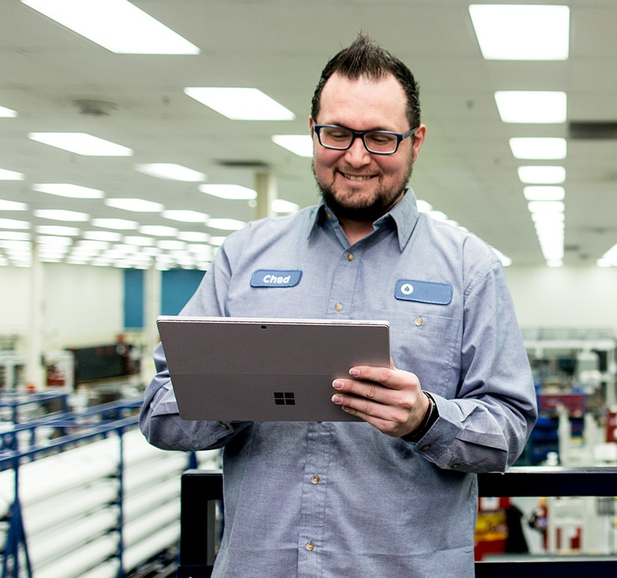
Lesson 1
Working with Environments
Data
Cloud
AI

Slide 5



What are Environments?
Virtual Python environments:
Specific packages installed
Consistent execution context

Slide 6
Explicitly Creating Environments
Create from specification file
Create from existing environment
Create with specified packages
env = Environment.from_conda_specification(name='training_environment',
file_path='./conda.yml')
env = Environment.from_existing_conda_environment(name='training_environment',
conda_environment_name='py36')
env = Environment('training_environment')
deps = CondaDependencies.create(conda_packages=['scikit-learn','pandas'],
pip_packages=['azureml-sdk']
env.python.conda_dependencies = deps

Slide 7
Registering and Reusing Environments
Register an environment in the workspace
View Registered Environments
Retrieve and use an environment
env.register(workspace=ws)
env_names = Environment.list(workspace=ws)
for env_name in env_names:
print('Name:',env_name)
training_env = Environment.get(workspace=ws, name='training_environment')
estimator = Estimator( source_directory='experiment_folder',
entry_script='training_script.py',
compute_target='local',
environment_definition=training_env)

Slide 8
Curated Environments
Built-in environments for common scenarios:
AzureML-Minimal
AzureML-Scikit-learn-0.20.3
AzureML-TensorFlow-2.0-CPU
AzureML-TensorFlow-2.0-GPU
AzureML-PyTorch-1.3-CPU
AzureML-PyTorch-1.3-GPU
Others

Slide 9
Lab 5A
Working with Environments
https://aka.ms/msl-dp100

Slide 10
Lesson Review
Complete the Review Questions

Slide 11
Lesson 2
Working with Compute Targets
Data
Cloud
AI

Slide 12


What are Compute Targets?
Flexible compute contexts for running code:
Develop and test on low-cost compute before moving workloads to production.
Run processing tasks on the most appropriate compute
Cost-Effective Scalability
Pay only when running
Scale-out on-demand

Slide 13
Types of Compute
Local
Compute context where experiment submission code runs
Compute Cluster
Virtual cluster managed by Azure Machine Learning
Inference Cluster
Container-based deployment target
Attached Compute
Azure Virtual Machine
Azure Databricks
others

Slide 14
Creating Compute Targets
Create in Azure Machine Learning studio
or
Use the SDK
from azureml.core.compute import ComputeTarget, AmlCompute
compute_name = 'aml-cluster'
compute_config = AmlCompute.provisioning_configuration(vm_size='STANDARD_DS12_V2',
max_nodes=4)
aml_compute = ComputeTarget.create(ws, compute_name, compute_config)
aml_compute.wait_for_completion(show_output=True)

Slide 15
Using Compute Targets
Specify the compute target for an experiment
Compute target name
ComputeTarget object
estimator = Estimator(source_directory='experiment_folder',
entry_script='training_script.py',
environment_definition=training_env,
compute_target='aml-cluster')

Slide 16
Lab 5B
Working with Compute Targets
https://aka.ms/msl-dp100

Slide 17
Lesson Review
Complete the Review Questions

